Slide 1
Minnesota Child Poverty Analysis 2015
Shrijit
Steffie
Muzaani

Slide 2
Introduction
Objective of Project is to determine the factors that would help us determine the % of Child Poverty.
Our Census Dataset was obtained from (KAGGLE)
https://www.kaggle.com/muonneutrino/us-census-demographic-data/data
Created a subset with only Minnesota State in it.
We primarily used R as well as JMP to analyze and build predictive models.

Slide 3
Model Selection
Full Model (includes all regressors)
There were only 4 regressor that were significant out of 33 and had high VIFS which is an indication of multicollinearity.
We then used stepwise, backwards and subset regression to find a better model.
After analyzing we chose the model chosen by the subset regression with 7 regressors.
All models had influential points but model with 7 regressors performed the best in most of the performance measures.
Notes:
Full model had 33 regressors and t-test showed that only 4 of them were significant. Also checked for multicollinearity using VIFS and correlation matrix. Found out that VIFS for almost all regressors are > 10. To select a better predictive model, we used the selection process ( stepwise, backwards and forwards), and also the subset regression method. We compared these 3 models and found that the model obtained using the subset regression method was the best.

Slide 4
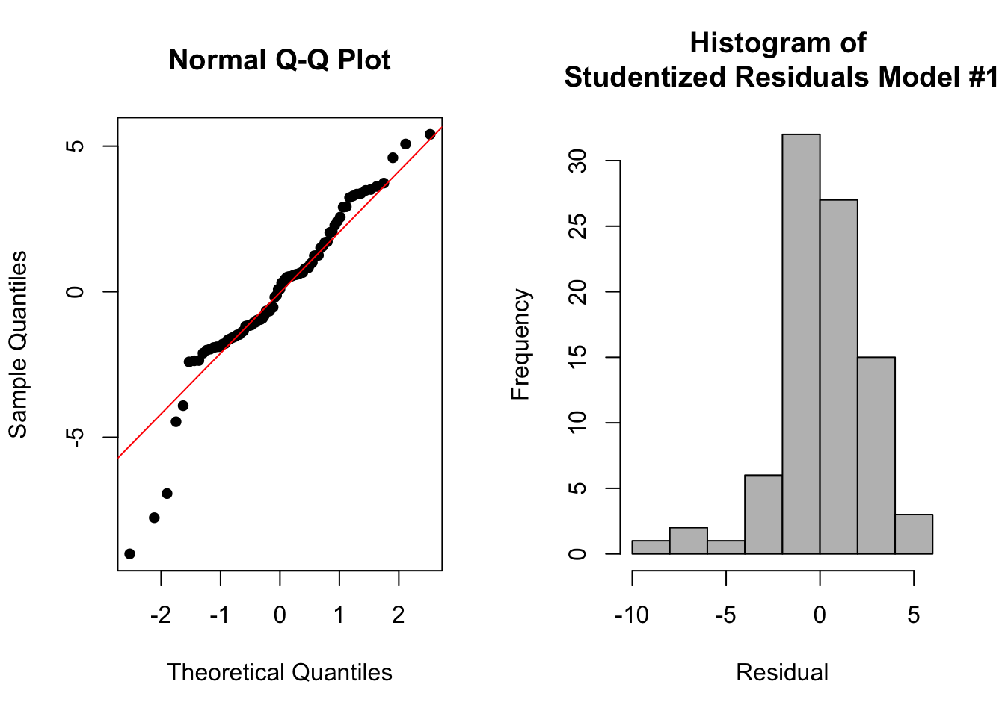
7 regressor model.
Child Poverty = 7.54 – 0.0726*Whites + 0.0005586*IncomePerCapita + 1.2106*Poverty – 0.3279*Professional -0.385*Office -0.5697*Walk + 0.3819*SelfEmployed
Histogram ( skewness )
Press = 749.4979
Notes:
Slight problem in skewness and normality

Slide 5
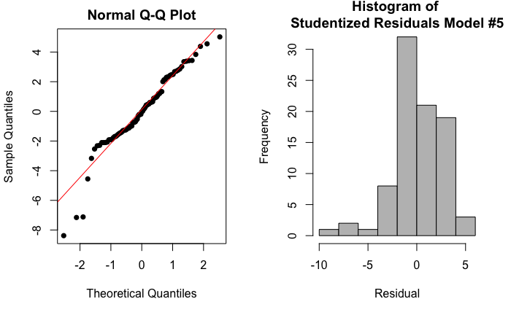
Transformed model.
PRESS of 445.31
Notes:
Altho it did not change the QQ plot and Histograms much, we suspect it’s due to the outliers

Slide 6
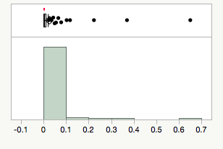
Influential Pt.
Influential points (7,16,75) were excluded to see if it affects the model.

Slide 7
Removing the outliers shows solves the problem of normality and linearity.

Slide 8
Models Overview
Model | AIC | BIC | PRESS | Adj R-Sq
Reg. Subset | 423.854 | 446.0462 | 749.5 | 79.63%
Stepwise | 421.6517 | 470.9699 | 768.43 | 82.08%
Backwards | 421.7137 | 468.5659 | 760.46 | 82.91%
Transformed | 378.5902 | 400.7834 | 445.31 | 79.40%
Infl. Removed | 325.19 | 342.72 | 232.42 | 87.54%

Slide 9
Final Model
Child Poverty = 7.54 – 0.0726*Whites + 0.0005586*IncomePerCapita + 1.2106*Poverty – 0.3279*Professional -0.385*Office -0.5697*Walk + 0.3819*SelfEmployed
Two interesting factors are Income Per Capita and Walk that were not performing the way we expected it to.

Slide 10
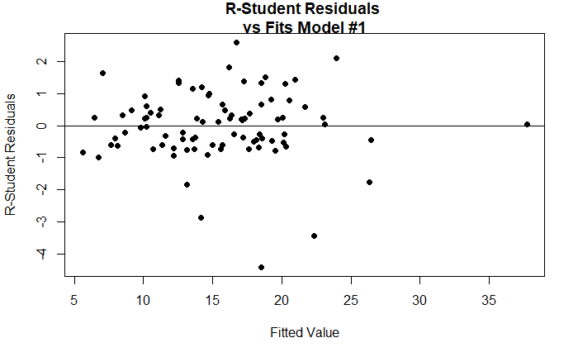

Slide 11
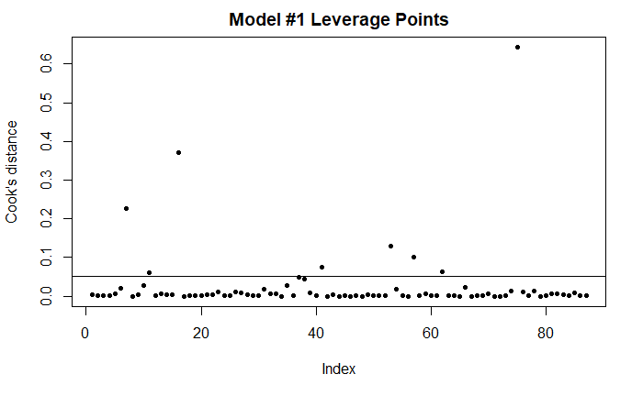

Slide 12
